Slide 1


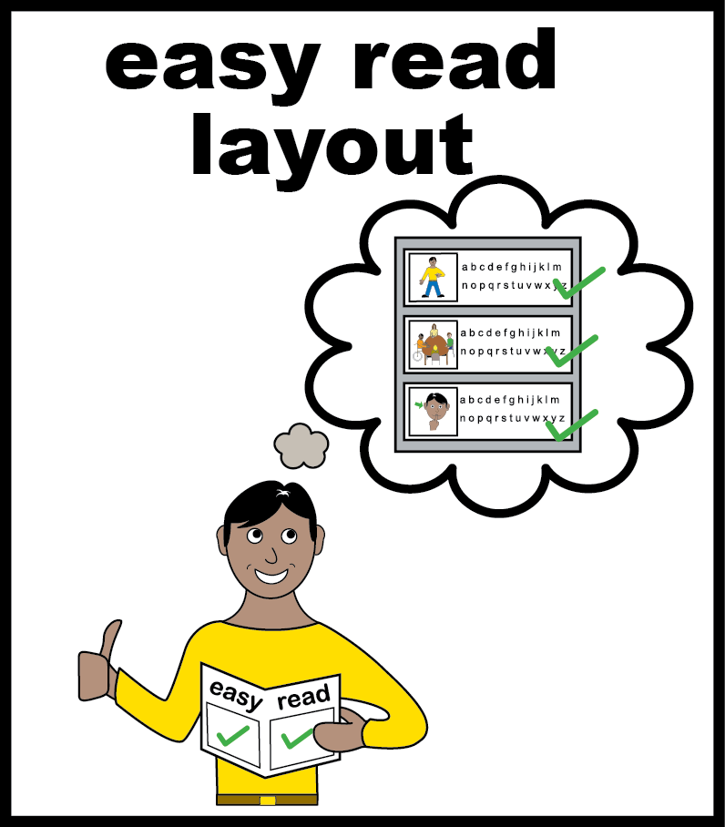

Learning Disability Improvement Standards (Round 7)
Easy Read Report

Slide 2
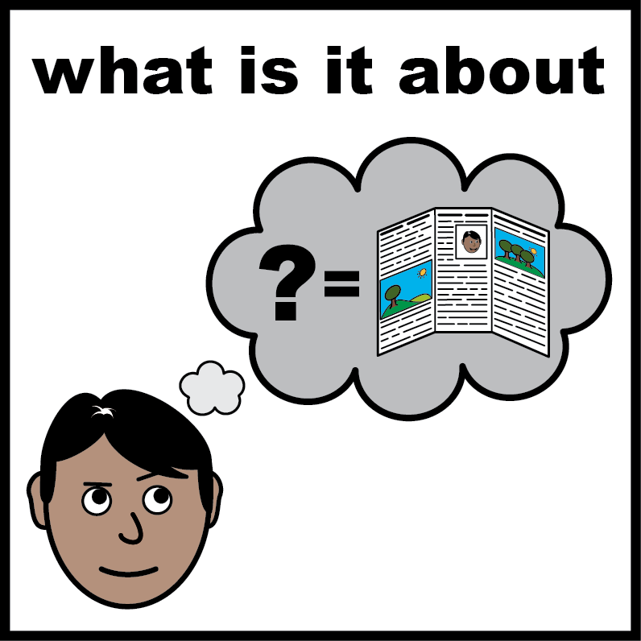
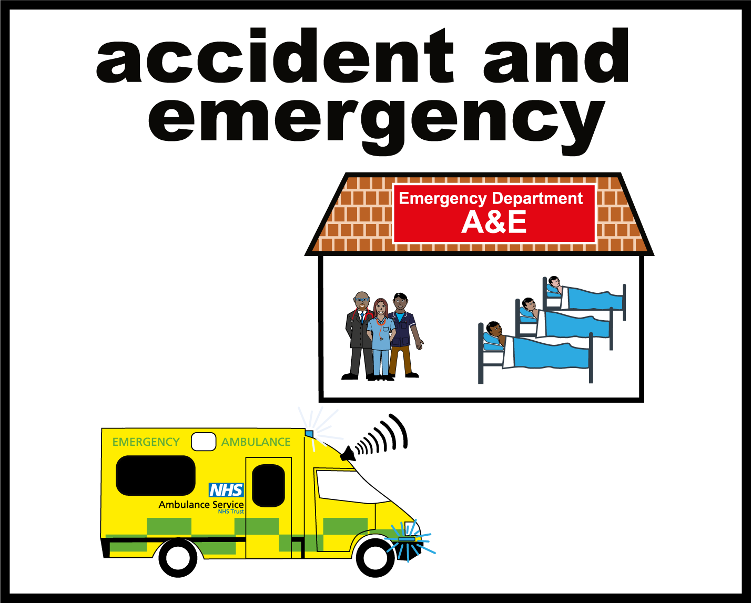
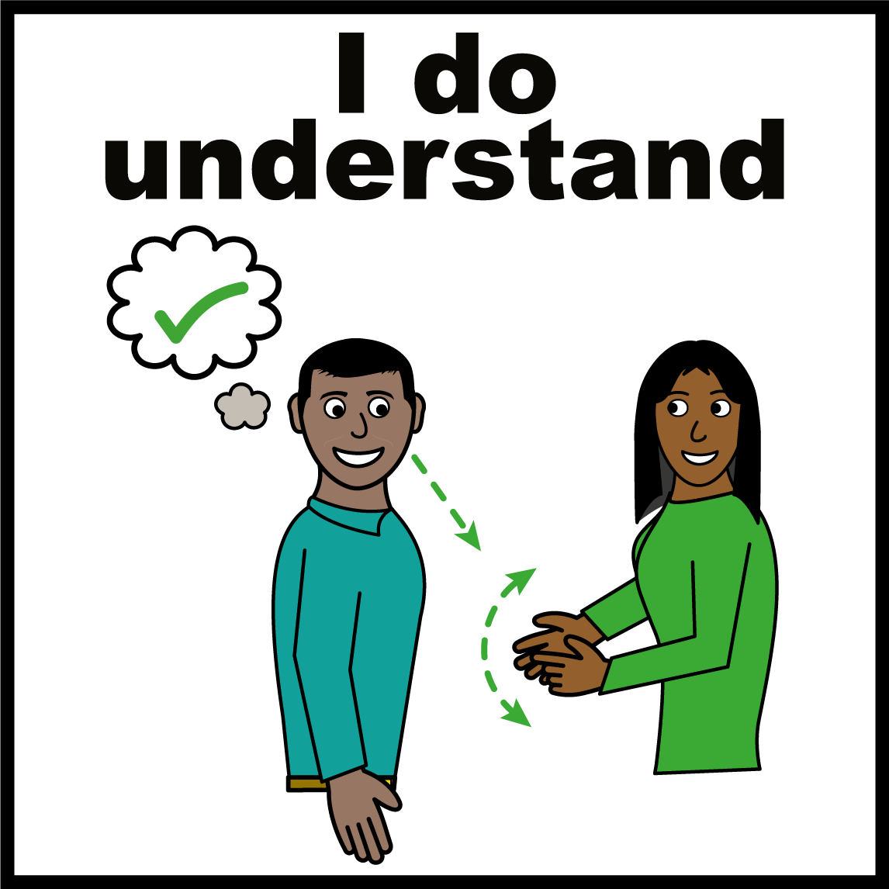
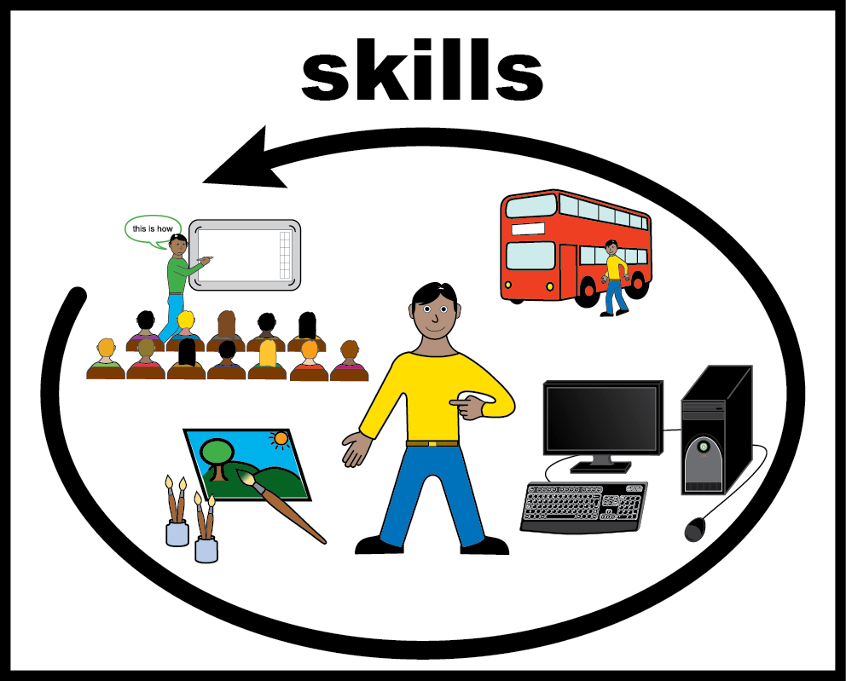
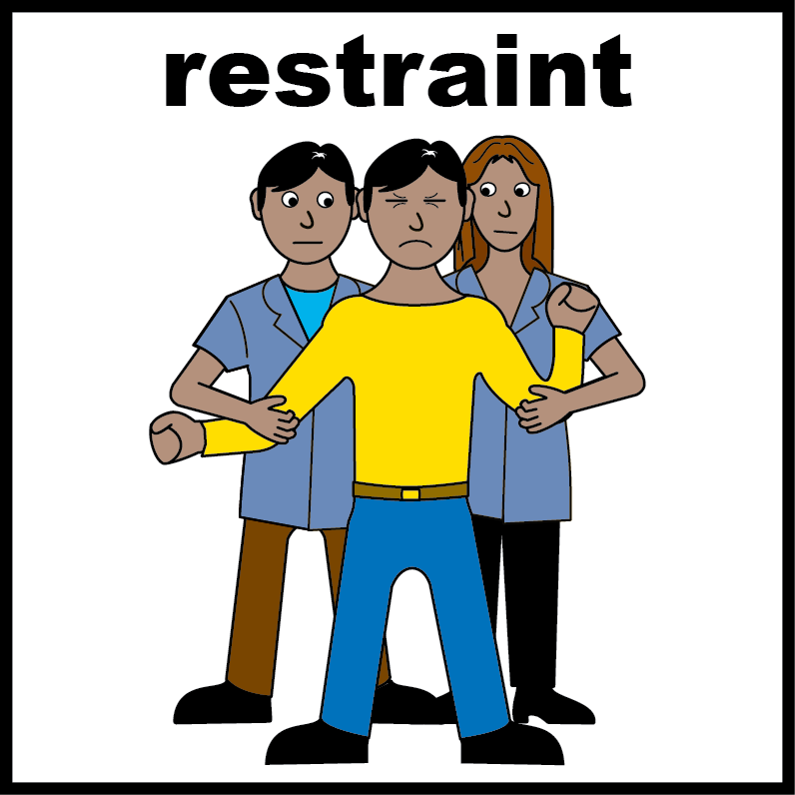
Contents
Page
 | Information | 3
 | Getting help quickly and being treated well | 5
 | Being listened to and having a say in your care | 7
 | Staff being trained to do their job well | 9
 | Keeping people safe and reducing restraint | 10

Slide 3
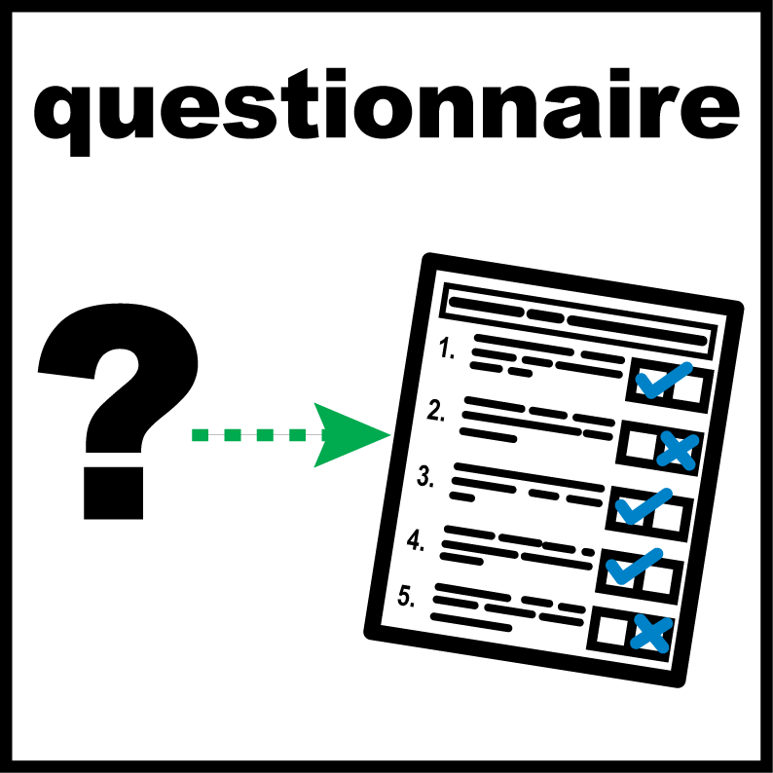
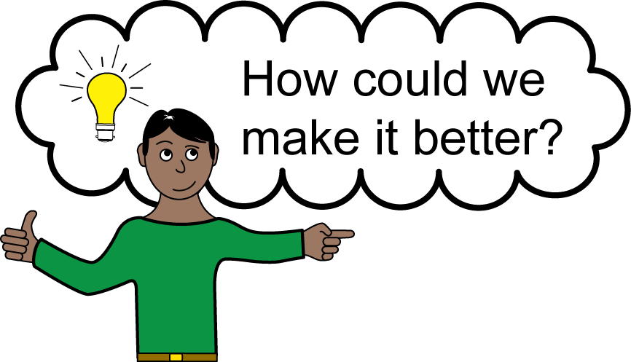
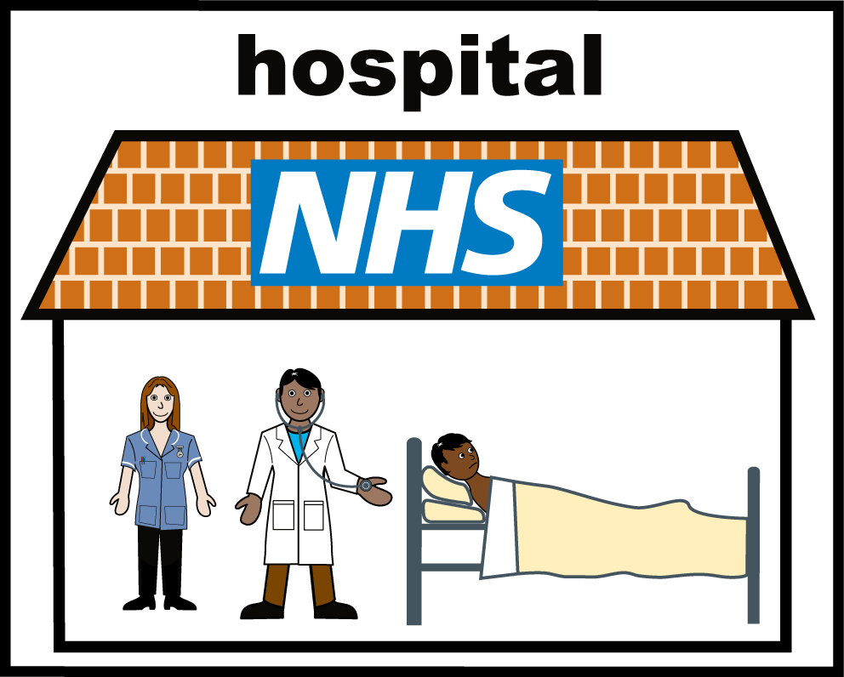
About the Standards
NHS England worked with people who use health services, their families, and NHS staff.
Together they created 4 standards. Standards help measure how good a service is.
They help the NHS improve the care it gives to people.
NHS Benchmarking Network asked NHS trusts in England if they are meeting the 4 standards.
What does “NHS Benchmarking Network" mean?
The NHS Benchmarking Network (NHSBN) helps hospitals and care services learn from information so they can improve.
3

Slide 4
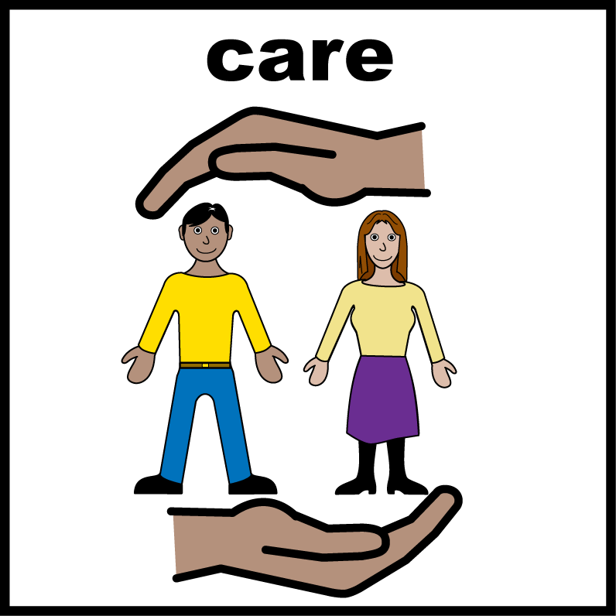
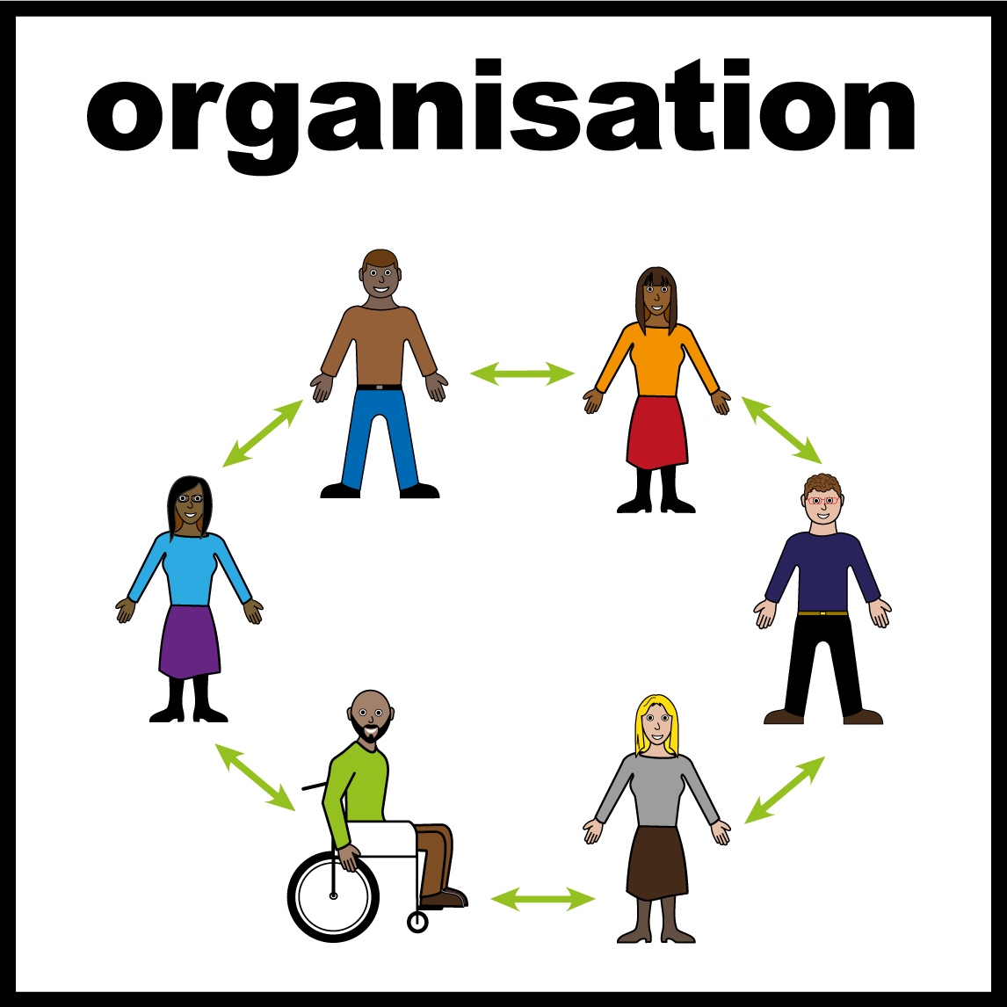
About the Standards
They asked people with a learning disability, autistic people, and their families about the care they had in hospital.
What does “NHS Trust" mean?
An NHS Trust runs hospitals and health services in an area.
A Trust is not a building. It is the organisation in charge.
One Trust can run more than one hospital.
When this report says “Trust“, it means the organisation, not the hospital building.
4

Slide 5
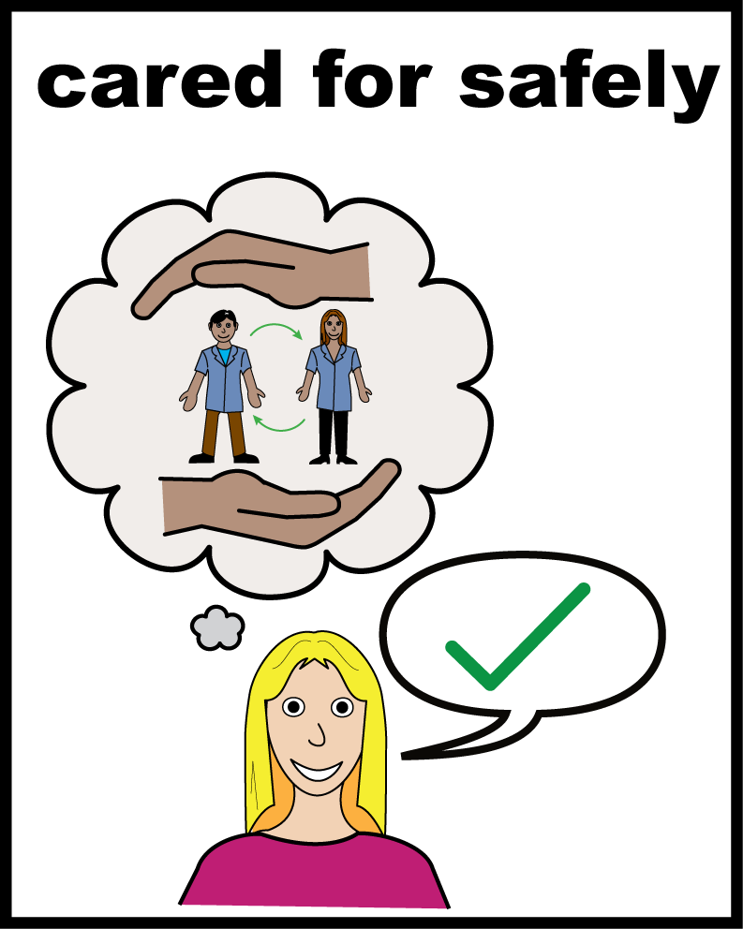
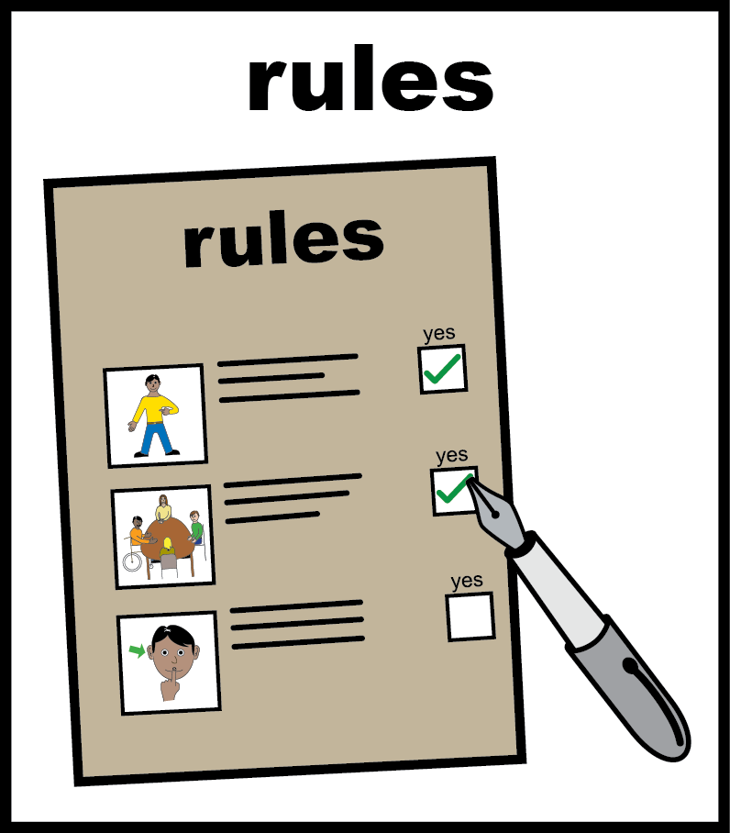
Getting help quickly and being treated well
Half of staff said people with a learning disability or autistic people always get the changes they need to use services.
9 out of 10 trusts had rules about restraint. The rules were for children, young people, adults with a learning disability and autistic people
What does “restraint" mean?
Restraint is when staff stop a person from moving or doing what they want. This can mean holding a person, giving them medicine to calm them down, or stopping them from leaving a room.

Slide 6
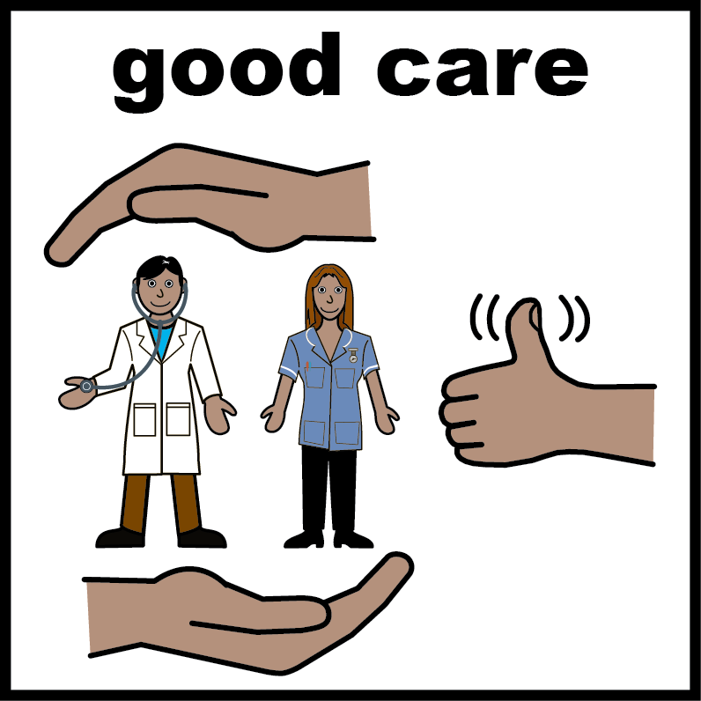
Getting help quickly and being treated well
3 out of 5 staff said people with a learning disability or autistic people get the same quality of care as other patients.

Slide 7
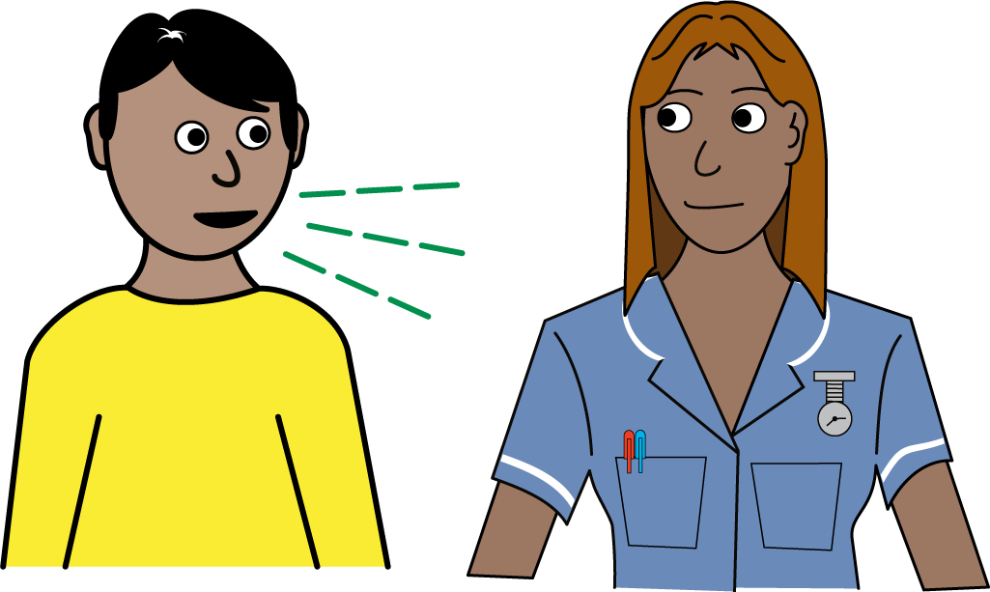
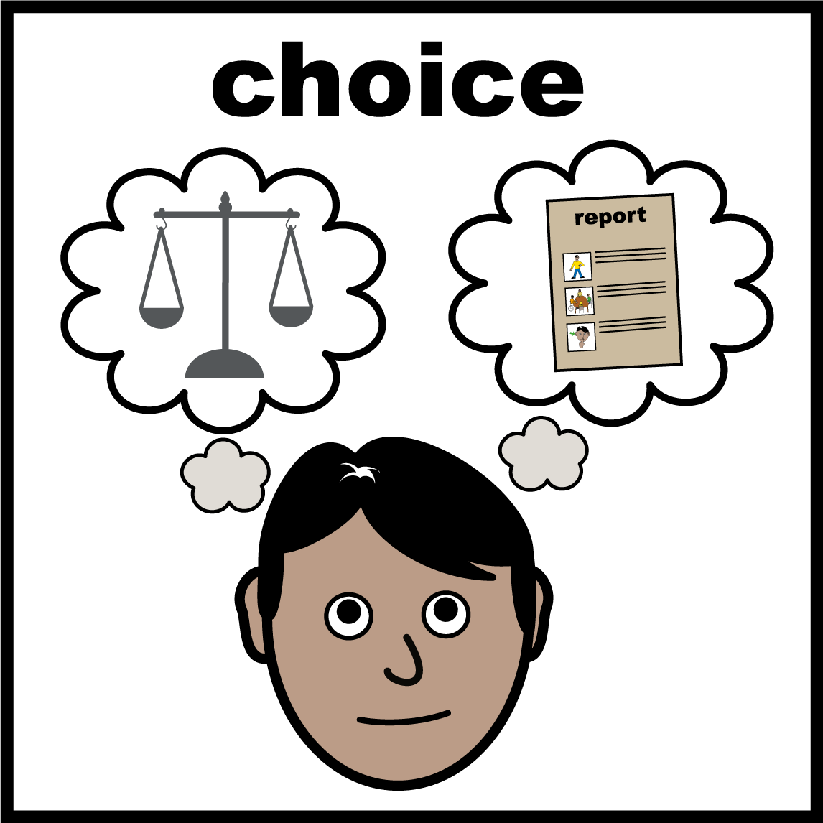
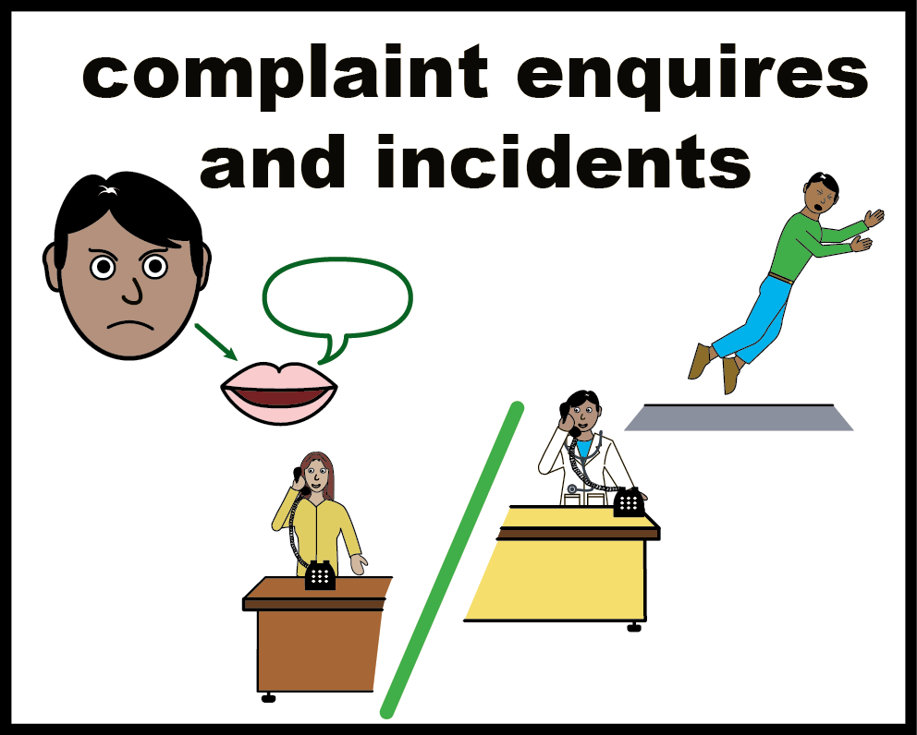
Being listened to and having a say in your care
4 out of 5 staff said they often involve people with a learning disability or autistic people in decisions about their care.
Families are involved more often, with 4 out of 5 staff saying families are involved in care planning.
3 out of 5 trusts use Ask, Listen, Do resources. These help trusts learn from feedback, worries and complaints.
What does "Ask, Listen, Do" mean?
It is a set of rules that helps the NHS make it easier for people with a learning disability and autistic people to give feedback, raise concerns, and make complaints.

Slide 8
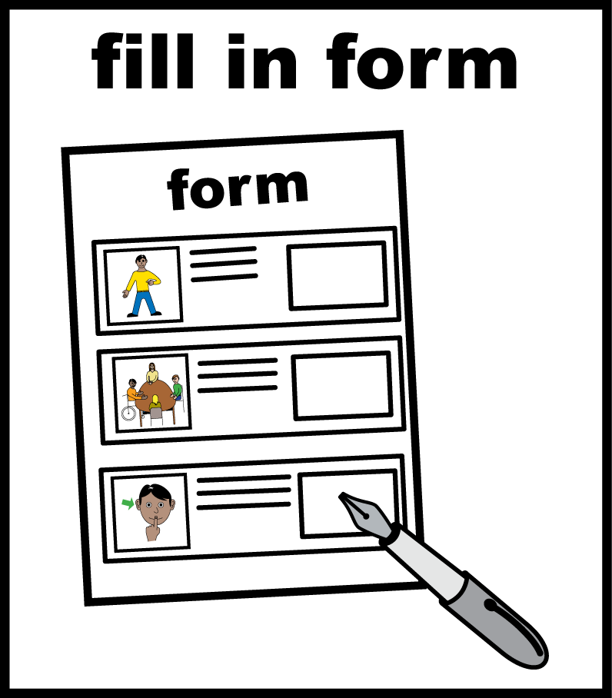
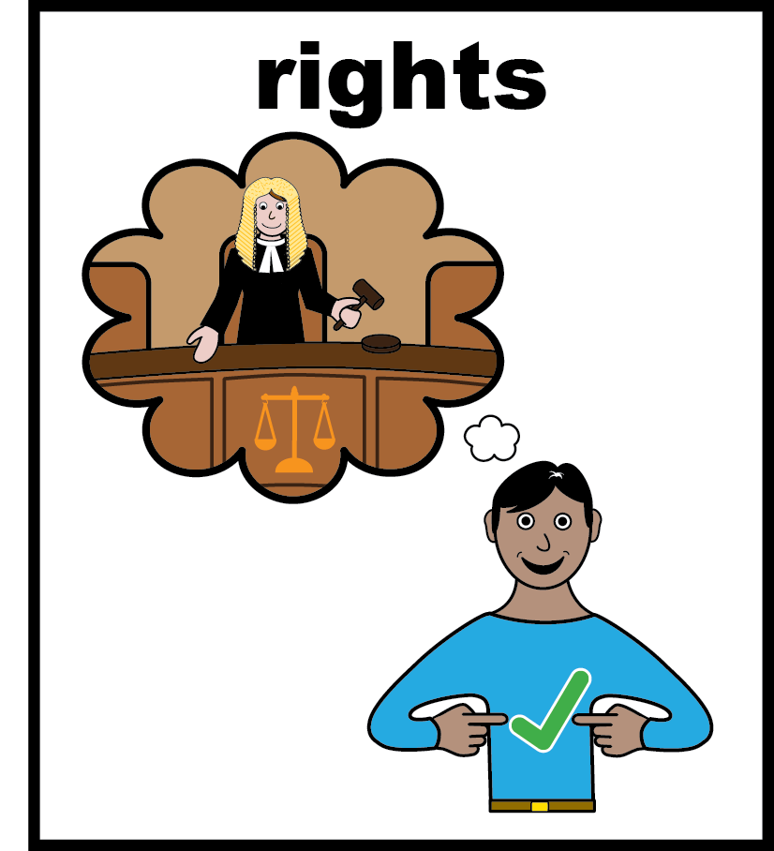
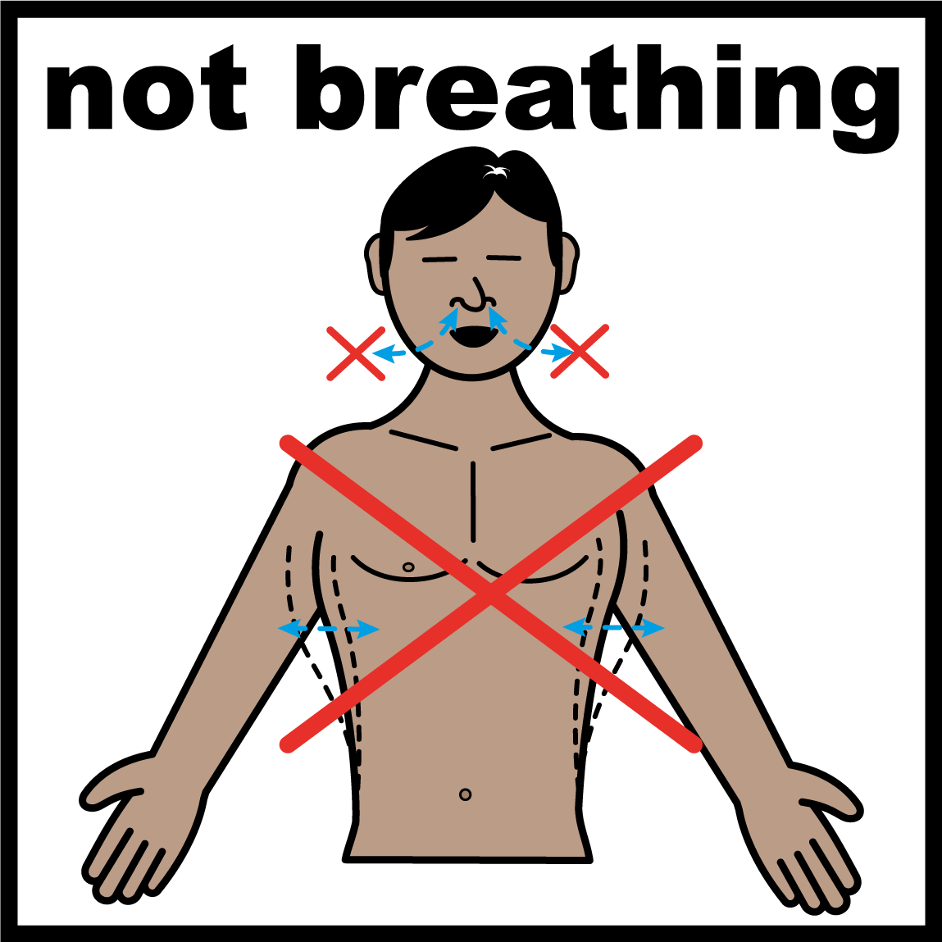
Being listened to and having a say in your care
1 out of 3 staff said their Trust has a clear rule for checking DNACPR forms. These forms are about trying to restart someone's heart if it stops.
1 out of 3 staff said they always tell people with a learning disability and their families about their rights when they use services.
What does “DNACPR" mean?
Sometimes a person's heart or breathing stops. Staff can try to start it again. This is called CPR. A DNACPR is a decision that staff will not try CPR for a person. Doctors must talk to the person and their family before making this decision. It should never happen just because a person has a learning disability

Slide 9
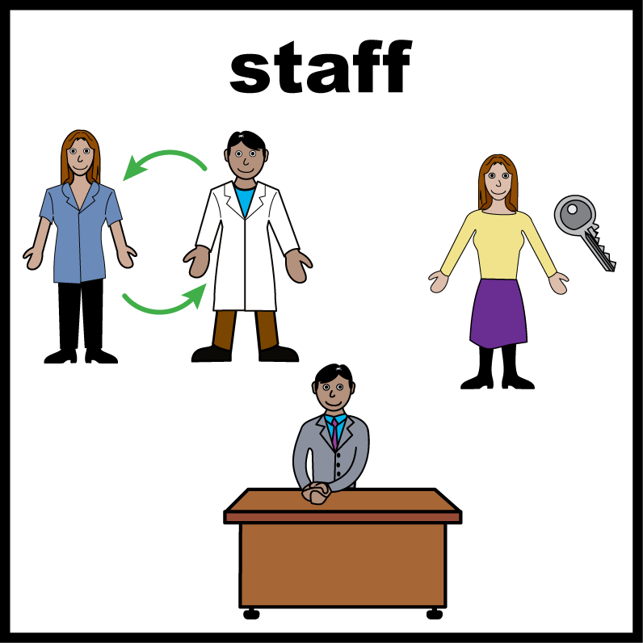
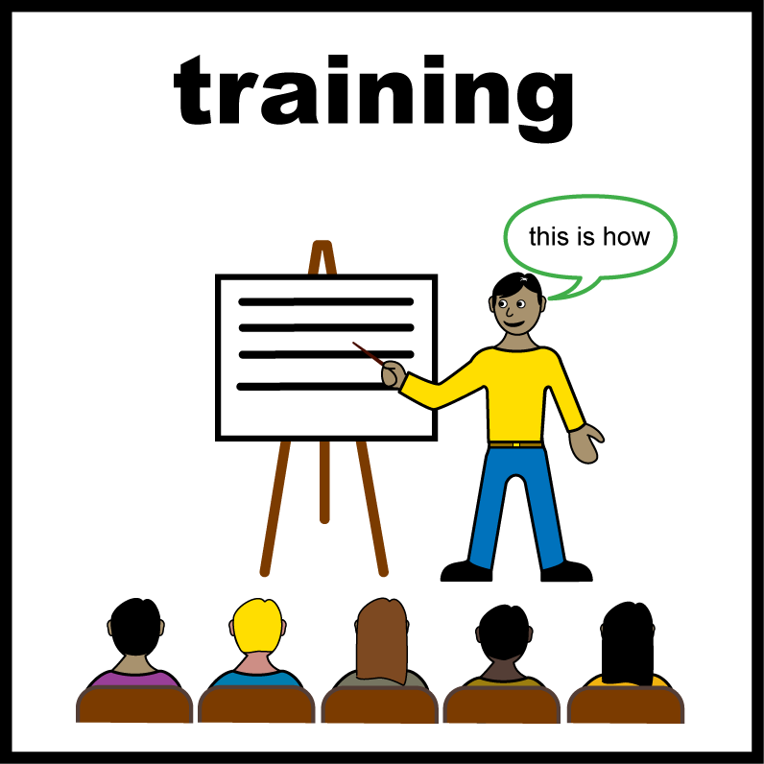
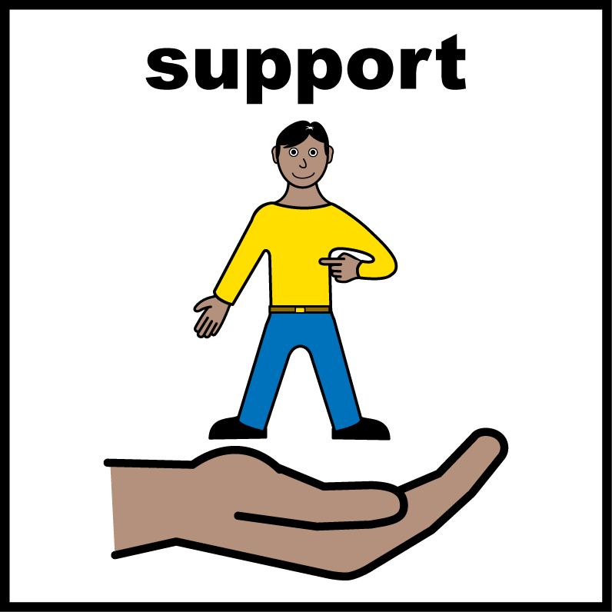
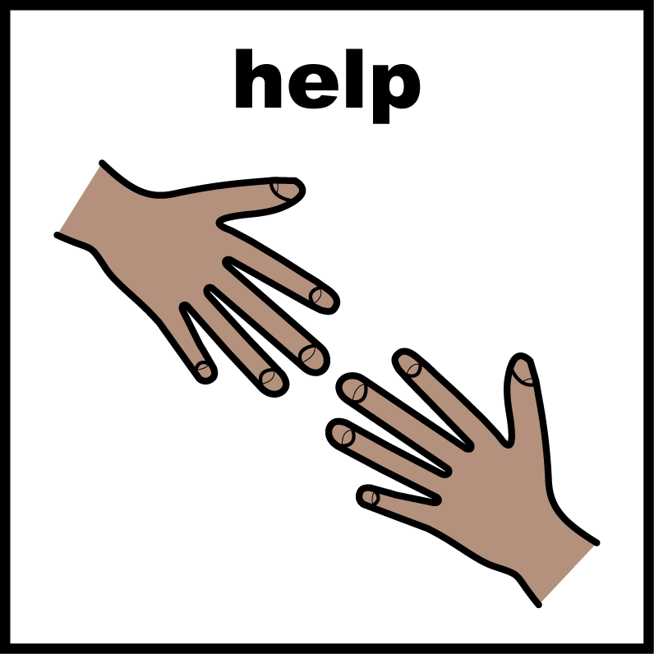
Staff being trained to do their job well
1 out of 4 Trusts involve people with a learning disability or autistic people when new staff start work.
Half of staff said they have the things and support they need to help people with a learning disability or autistic people.
3 out of 4 staff say they know how to support people with a learning disability and autistic people in their work.
2 out of 3 staff said they can get help from learning disability staff when they need it.
2 out of 3 staff said they can always give safe care to people with a learning disability or autistic people.

Slide 10
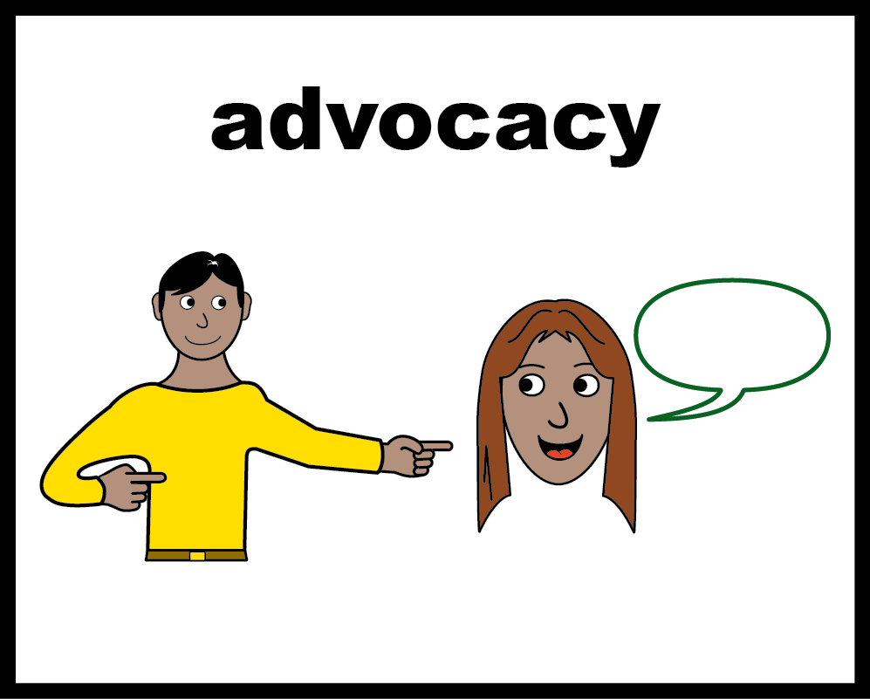
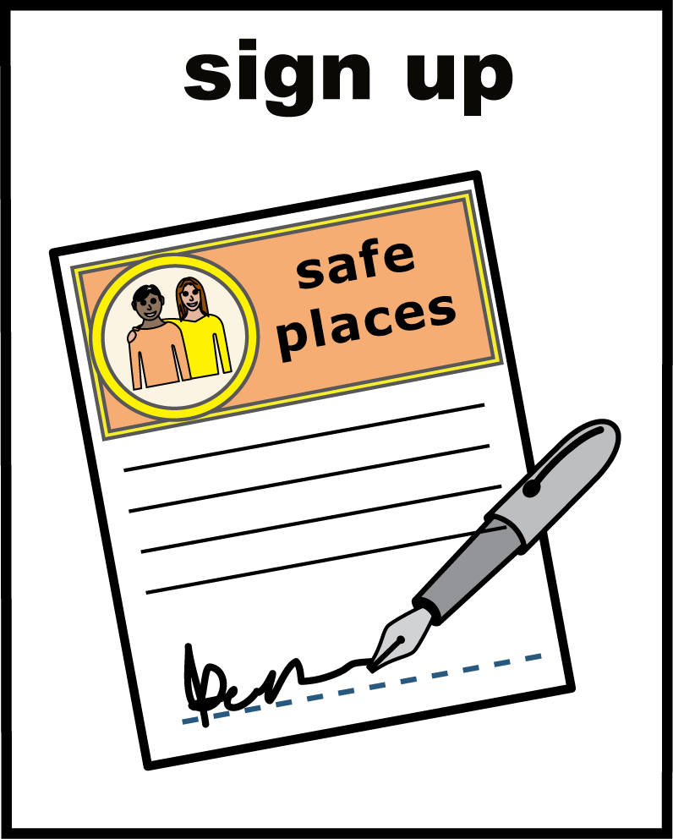
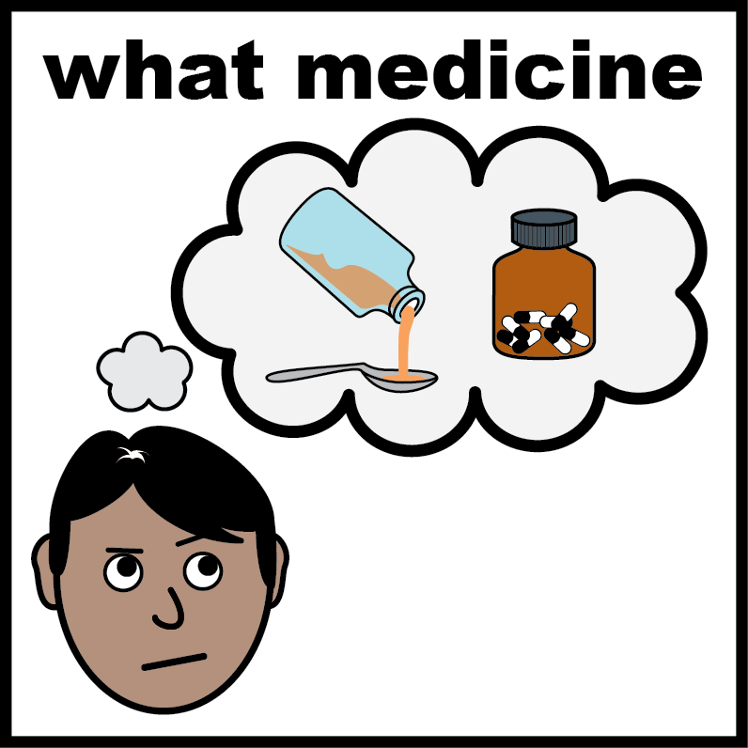

Keeping people safe and reducing restraint
9 out of 10 Trusts help people get advocacy, including peer advocacy. Advocacy means support to speak up.
9 out of 0 trusts signed the STOMP pledge.
Only 2 out of 5 staff said people with a learning disability, autistic people and families help check medicines that affect mood or behaviour.
What is the “STOMP pledge“?
The STOMP pledge is a promise to stop giving too much medicine to people with a learning disability or autistic people.

Slide 11
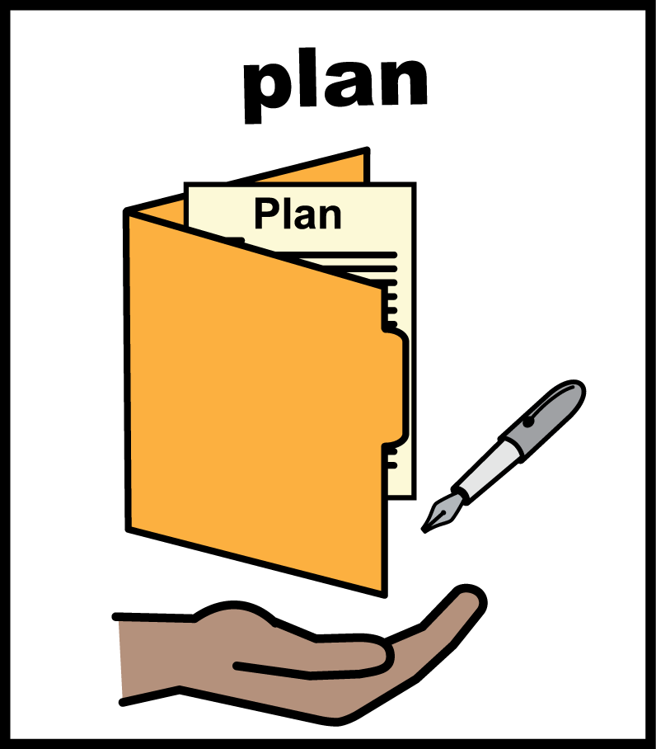
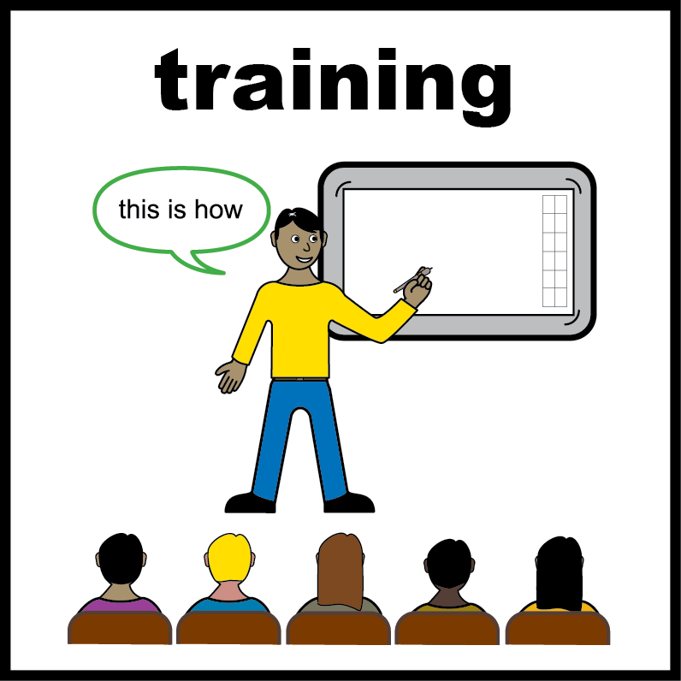
Keeping people safe and reducing restraint
Nearly all trusts had a plan to use less restraint.
3 out of 5 staff said they had training on how to restrain people less, and other ways to keep people safe.
What does “restraint" mean?
Restraint is when staff stop a person from moving or doing what they want. This can mean holding a person, giving them medicine to calm them down, or stopping them from leaving a room.

Slide 12
www.nhsbenchmarking.nhs.uk
Find out more:

